Slide 1
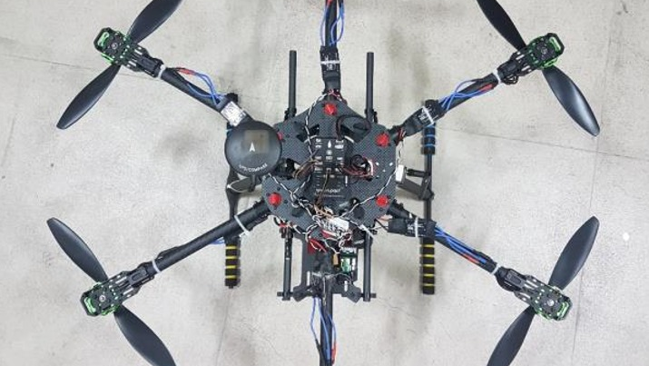
4i InNDrone

Slide 2
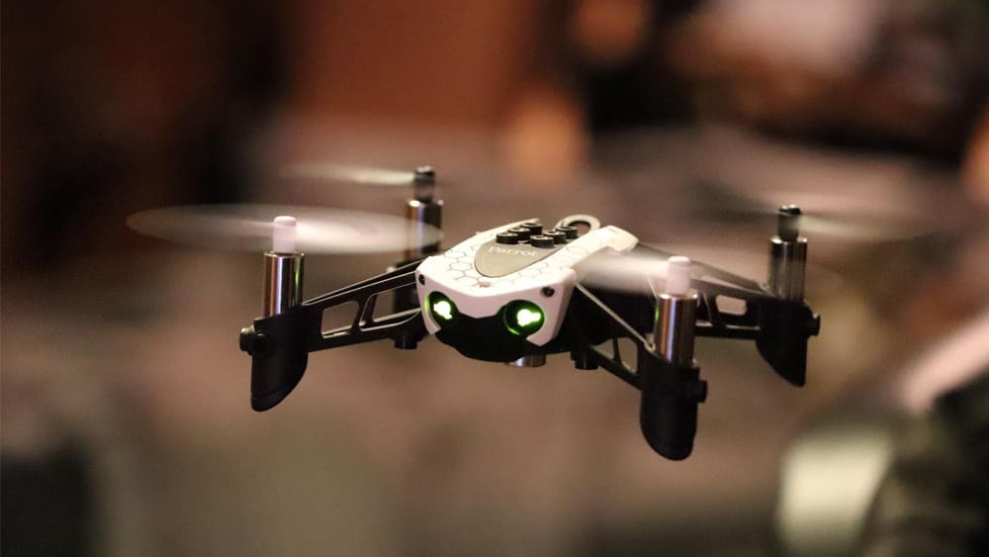
It is very hard to inspect areas where hazardous situations like fire accidents, earthquakes takes place. In that cases inspecting areas by humans directly is very dangerous.
At that kind of situations, using drones are very helpful and reduce danger.
Since the area where drones are inspecting is unknown, so we do not know where obstacles are present. So, our drone must have power to sense the obstacle near its vicinity and made path accordingly. So, it need to respond quickly, for that our drone must be autonomous.

Slide 3
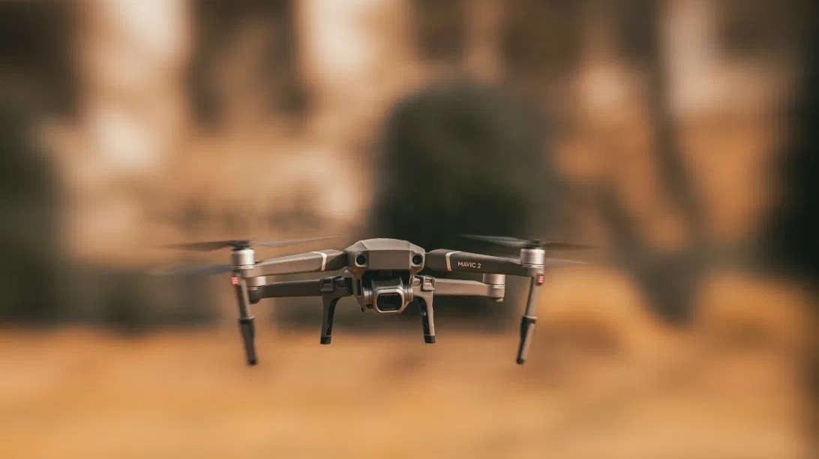
To fly autonomously, drones need to know their position in the environment, and hence need GPS. But in closed indoor environments finding GPS is very hard. In such cases, navigation of UAV is not possible.
We need to make drones where it also has an ability to navigate in indoor environments without using GPS.

Slide 4
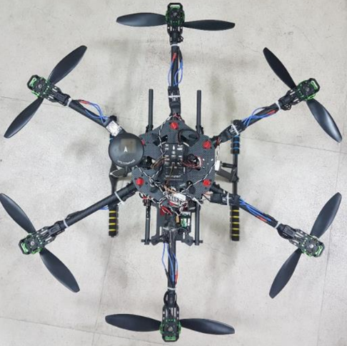
4i InNDrone is a completely autonomous drone which can navigate itself in indoor environment without using GPS.
We divided this project into 4 major modules
SLAM(3D)
Indoor Localization and Positioning
Path Planning
Obstacle Avoidance

Slide 5
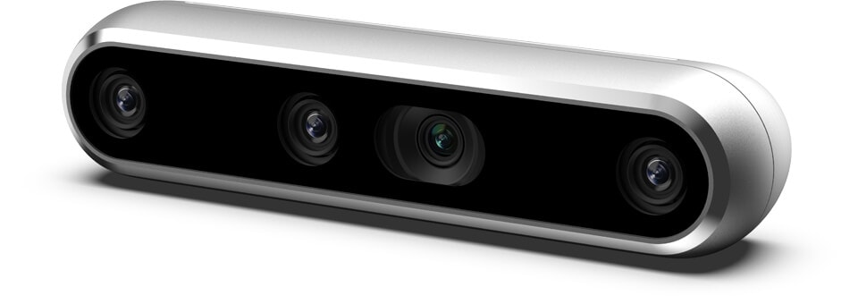
SLAM
SLAM stands for Simultaneous Localization and Mapping, which means mapping the local environment around it and localizing itself in the map it captured.
For doing this task, we are using depth camera

Slide 6
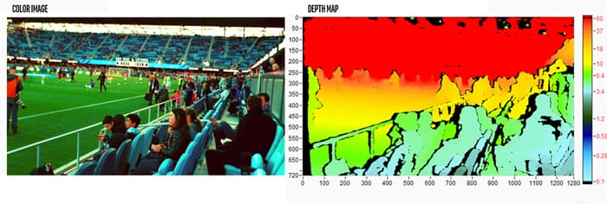

Slide 7
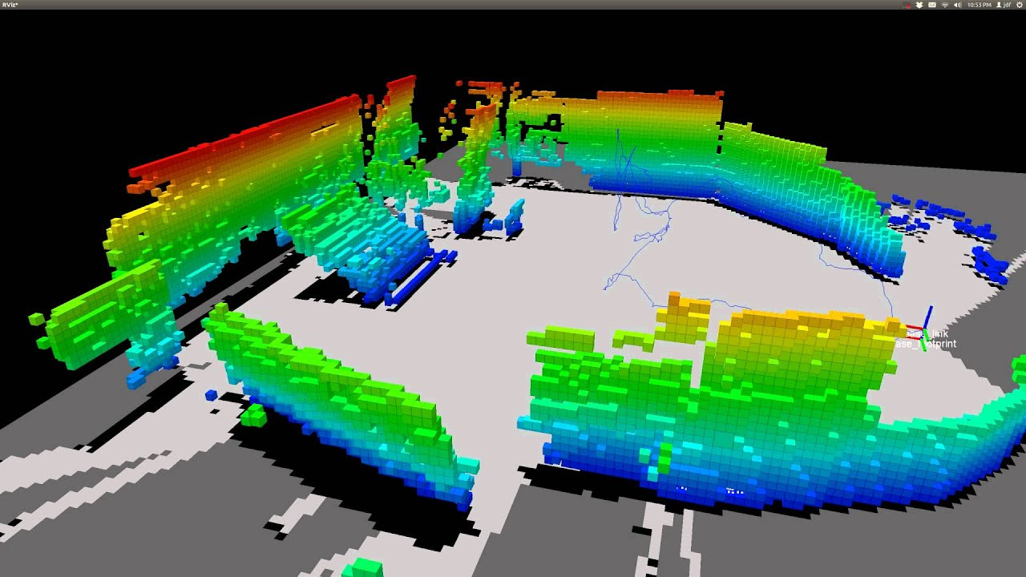
Final 3d map looks like

Slide 8
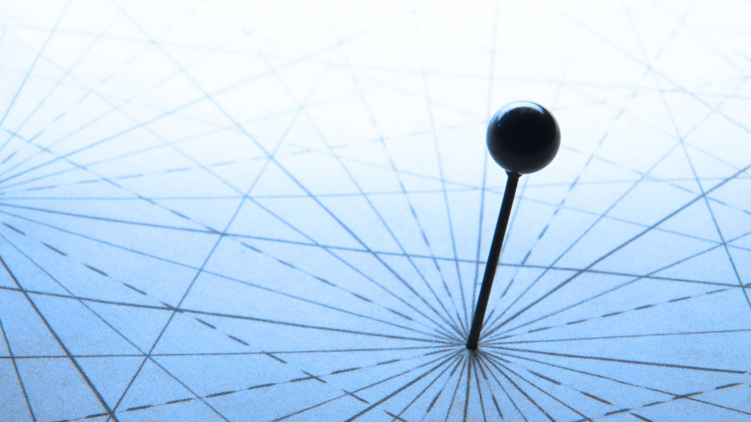
INDOOR LOCALIZATION AND Positioning:

Slide 9
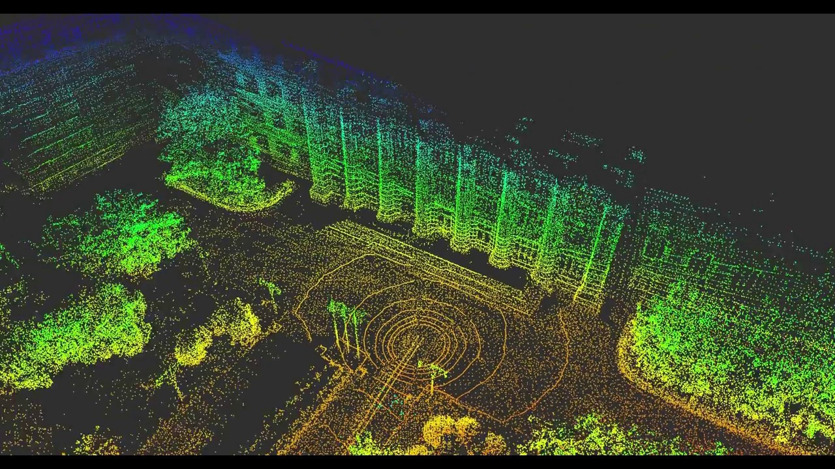
By SLAM, now we have whole map of environment.
The data from odometry is not accurate, sometimes we track wrong location of our drone in environment due to these erroneous odometry data, it is very hard for tracking the drone location accurately by using odometry data.
This is one of the major and interesting problem to tackle.
AMCL is one of the best technique to use to tackle the localization problem.
AMCL means Adaptive Monte Carlo Localization. This is probabilistic way of approach for localizing robots in known environment.

Slide 10

PATH PLANNING

Slide 11
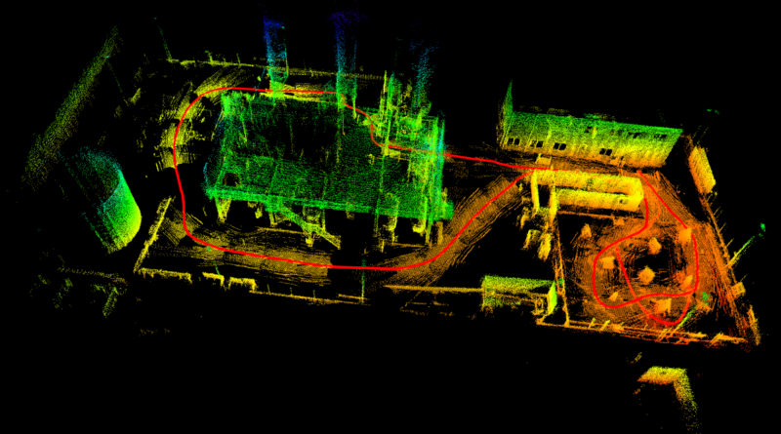
While performing SLAM, it just maps the local environment around that position and localize in it, but after that we need to move to other point for mapping.
To move like that we need to plan the path effectively from the current map we had and move along in it so that new parts of map are being mapped from points that is going along in its path planned.
From this new map, we got extra data, eventually our path updates from time goes on.
After full map is made, sometimes it also need to move from one position to other position in that environment. For that we need to plan path accordingly so that it takes very less time to reach the destination.

Slide 12

Obstacle Avoidance

Slide 13
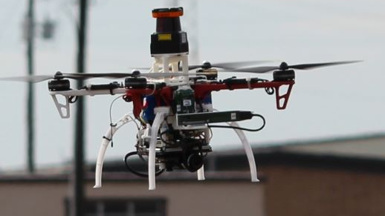
We aware of fact that localization is a very challenging task, sometimes even we use AMCL, our location will miss guided.
we don't know when the location of our drone get lost of its track, even it losts, it take some time to get in track.
or sometimes some new obstacle may appear after the mapping is done.
So, when this kind of things happen, our drone need to aware that the present obstacles in its near vicinity of its path by current data fed from depth camera and need to avoid collisions with it and update the map itself.
Obstacle avoidance is one of greatest challenge we need to face while doing things in real world with drone.

Slide 14

ROS
Here we are dealing with so many complex operations like 3d mapping, localization, instantaneous path planning, obstacle avoidance and many more.
To perform these tasks, it needs many sensors and onboard computer. To simplify our task by integrating all the sensor data and doing work accordingly, we are using ROS (Robotic Operating System), since it contains prebuilt packages which we can build upon to achieve the task.

Slide 15
THANK YOU

